Slide 1

CSE316
OPERATING SYSTEMS
Lecture #0
The kick start session

Slide 2





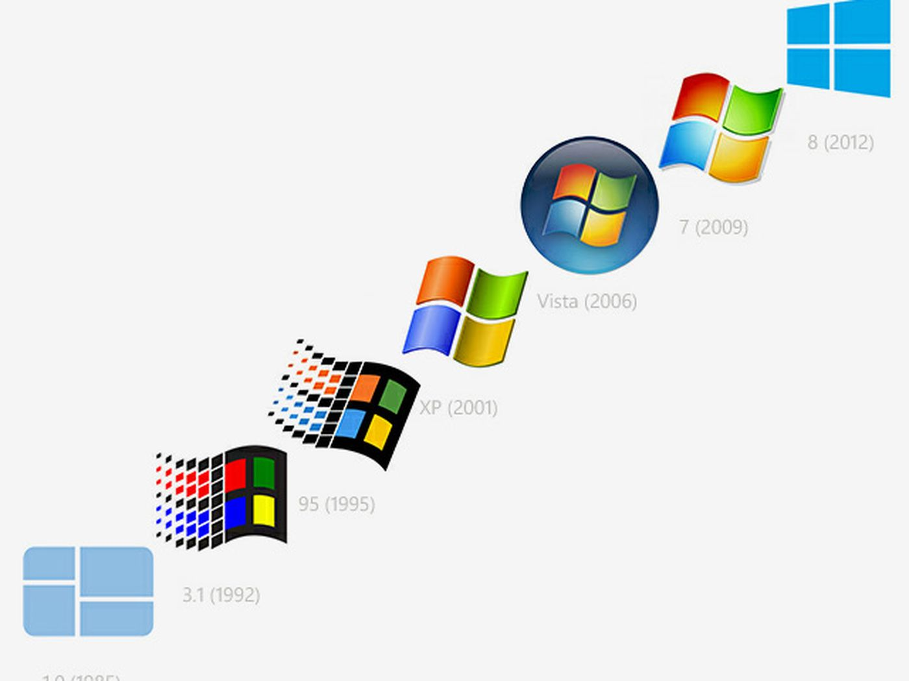


Operating Systems

Slide 3
Course details
LTP – 3 0 0 [Three lectures/week]
Credit – 3

Slide 4
Assessment/Evaluation Scheme
Attendance: 5%
CA: 25%
MTT: 20%
ETT: 50%

Slide 5
Complete evaluation criteria for the course
CA1: 30 marks- Test (Online Quiz of 30 Questions)
To assess the students’ understanding on Introduction to Operating System, Process Management, CPU Scheduling, and Process Synchronization
NOTE: The CA1 will be allocated in 5th Week and conducted in 6th Week.
CA2: 30 marks- Test (Class Test-Student will write the answers on test sheets)
To assess the students’ understanding on Threads, Deadlock, Protection and Security, and Memory Management.
NOTE: The CA2 will be allocated in 11th Week and conducted in 12th Week.
CA3: 30 marks- Test (Simulation Based Assignment)
To assess the students’ logic building and programming skills. Scenario-based problems on operating system concepts will be given to code in C language. The students will code and submit the code online withing stipulated time.
NOTE: The CA3 will be allocated in 3rd Week and student will submit it in 10th Week.

Slide 6

Revised Bloom’s Taxonomy

Slide 7
Course outcomes
Through this course students should be able to:
CO1 :: understand the role, functionality and layering of the system software components.
CO2 :: use system calls for managing processes, memory and the file system.
CO3 :: Analyze important algorithms eg process scheduling and memory management algorithms.
CO4 :: use and outline the various security measures that ensure threat free operation of a system.
CO5 :: apply various operations on processes, threads and analyze methods to synchronize their execution.
CO6 :: simulate inter-process communication techniques like message passing and shared memory.

Slide 8
Program Outcomes
PO1
Engineering knowledge: Apply the knowledge of mathematics, science, engineering fundamentals, and an engineering specialization to the solution of complex engineering problems.
PO2
Problem analysis::Identify, formulate, research literature, and analyze complex engineering problems reaching substantiated conclusions using first principles of mathematics, natural sciences, and engineering sciences.
PO3
Design/development of solutions::Design solutions for complex engineering problems and design system components or processes that meet the specified needs with appropriate consideration for the public health and safety, and the cultural, societal, and environmental considerations.
PO4
Conduct investigations of complex problems::Use research-based knowledge and research methods including design of experiments, analysis and interpretation of data, and synthesis of the information to provide valid conclusions.

Slide 9
Program Outcomes
PO5
Modern tool usage::Create, select, and apply appropriate techniques, resources, and modern engineering and IT tools including prediction and modeling to complex engineering activities with an understanding of the limitations.
PO6
The engineer and society::Apply reasoning informed by the contextual knowledge to assess societal, health, safety, legal and cultural issues and the consequent responsibilities relevant to the professional engineering practice.
PO7
Environment and sustainability::Understand the impact of the professional engineering solutions in societal and environmental contexts, and demonstrate the knowledge of, and need for sustainable development.
PO8
Ethics::Apply ethical principles and commit to professional ethics and responsibilities and norms of the engineering practice.
PO9
Individual and team work::Function effectively as an individual, and as a member or leader in diverse teams, and in multidisciplinary settings.

Slide 10
Program Outcomes
PO10
Communication::Communicate effectively on complex engineering activities with the engineering community and with society at large, such as, being able to comprehend and write effective reports and design documentation, make effective presentations, and give and receive clear instructions.
PO11
Project management and finance::Demonstrate knowledge and understanding of the engineering, management principles and apply the same to one’s own work, as a member or a leader in a team, manage projects efficiently in respective disciplines and multidisciplinary environments after consideration of economic and financial factors.
PO12
Life-long learning::Recognize the need for, and have the preparation and ability to engage in independent and life-long learning in the broadest context of technological change.
PO13
Competitive Skills::Ability to compete in national and international technical events and building the competitive spirit alongwith having a good digital footprint.

Slide 11
Course contents
Unit I
Introduction to Operating System : Operating System Meaning, Supervisor & User Mode, review of computer organization, introduction to popular operating systems like UNIX, Windows, etc., OS structure, system calls, functions of OS, evolution of OS
Process Management : PCB, Operations on Processes, Co-operating and Independent Processes, Inter-Process Communication, Process states, Operations on processes, Process management in UNIX, Process concept, Life cycle, Process and threads

Slide 12
Course contents
Unit II
CPU Scheduling : Types of Scheduling, Scheduling Algorithms, Scheduling criteria, CPU scheduler - preemptive and non preemptive, Dispatcher, First come first serve, Shortest job first, Round robin, Priority, Multi level feedback queue, multiprocessor scheduling, real time scheduling, thread scheduling

Slide 13
Course contents
Unit III
Process Synchronization : Critical Section Problem, Semaphores, Concurrent processes, Cooperating processes, Precedence graph, Hierarchy of processes, Monitors, Dining Philosopher Problem, Reader-writer Problem, Producer consumer problem, classical two process and n-process solutions, hardware primitives for synchronization
Threads : Overview, Multithreading Models, scheduler activations, examples of threaded programs

Slide 14
Course contents
Unit IV
Deadlock : Deadlock Characterization, Handling of deadlocks- Deadlock Prevention, Deadlock Avoidance & Detection, Deadlock Recovery, Starvation
Protection and Security : Need for Security, Security Vulnerability like Buffer overflow, Trapdoors, Backdoors, cache poisoning etc, Authentication-Password based Authentication, Password Maintenance & Secure Communication, Application Security - Virus, Program Threats, Goals of protection, Principles of protection, Domain of protection, Access matrix, implementation of access matrix, System and network threats, Examples of attacks

Slide 15
Course contents
Unit V
Memory Management : Logical & Physical Address Space, Swapping, Contiguous Memory allocation, Paging, Segmentation, Page replacement algorithms, Segmentation - simple, multi-level and with paging, Page interrupt fault, Fragmentation - internal and external, Schemes - Paging - simple and multi level, Overlays - swapping, Virtual memory concept, Demand paging

Slide 16
Course contents
Unit VI
File Management : File Concepts, Access methods, Directory Structure, File System Mounting and Sharing, Protection, Allocation methods, Free-Space Management, Directory Implementation
Device management : Dedicated, shared and virtual devices, Serial access and direct access devices, Disk scheduling methods, Direct Access Storage Devices – Channels and Control Units
Inter process communication : Introduction to IPC (Inter process communication) Methods, Pipes - popen and pclose functions, Co-processes, Shared memory, Stream pipes, FIFOs, Message queues, Passing File descriptors, Semaphores

Slide 17
Mapped Cohorts
SOFTWARE DEVELOPMENT-(Product Based and Service Based) The business environment relies heavily on software for many functions - from automated traffic control systems to complex manufacturing processes, and Software Engineers are pivotal in the development of software that provides real solutions.
A Software Engineer needs to address the entire software development lifecycle - to analyze the needs, and then design, test and develop software in order to meet those needs. The career of a software engineer typically follows one of two primary paths: they either progress through greater responsibility and ownership over technical architecture and systems or they progress into managing teams of software engineers.

Slide 18
Why OS is a Star Course?
Operating system interview questions are mostly focused on process management(fork()), CPU scheduling algorithms, difference between a process and a thread, critical solution problem(mutex and semaphore) and memory management in operating system.

Slide 19
Why OS is a Star Course?-Contd.
In Computer Science and Engineering, Operating System is one of the scoring subject with respect to GATE exam. So, It is very important to know all the important topics of Operating System. As it has easily understandable theory and a really set pattern of questions. There is a really less probability of doing wrong in the questions of this subject if you know the concepts well.

Slide 20
Relevancy of OS for Placements
Operating system is one of the most important topic for Placement preparation. Following are the most important topics for Operating Systems –
CPU Scheduling
Process Synchronization
Deadlocks
Popular Algorithms
Processes and Threads
Memory Management
File and Disk Management

Slide 21
Text & Reference Books
Text Books:
1. OPERATING SYSTEM CONCEPTS by ABRAHAM SILBERSCHATZ, PETER B. GALVIN, GERG GAGNE, WILEY
References:
1. DESIGN OF THE UNIX OPERATING SYSTEM by MAURICE J. BACH, Pearson Education India
2. REAL-TIME SYSTEMS by JANE W. S. LIU, Pearson Education India

Slide 22
Importance of the course
Many of the recruiters (like TCS, CTS, HCL, IBM, Tech Mahindra, Amdocs etc.) ask operating systems in Technical Quiz and Technical Interview round.
This course is very important for GATE aspirants, it’s having good weightage in GATE.

Slide 23
Importance of the course
https://nptel.ac.in/courses/106105214
https://onlinecourses.nptel.ac.in/noc20_cs04/preview

Slide 24

Next Class: Introduction to Operating System

